Slide 2
MICROSOFT WORD
- Is a word processing program that lets you make letters, resumes, and many other types of documents.
- Part of the Microsoft Office productivity software suite.
- Was first released in 1983, and since then, it has been changed many times.

Slide 3
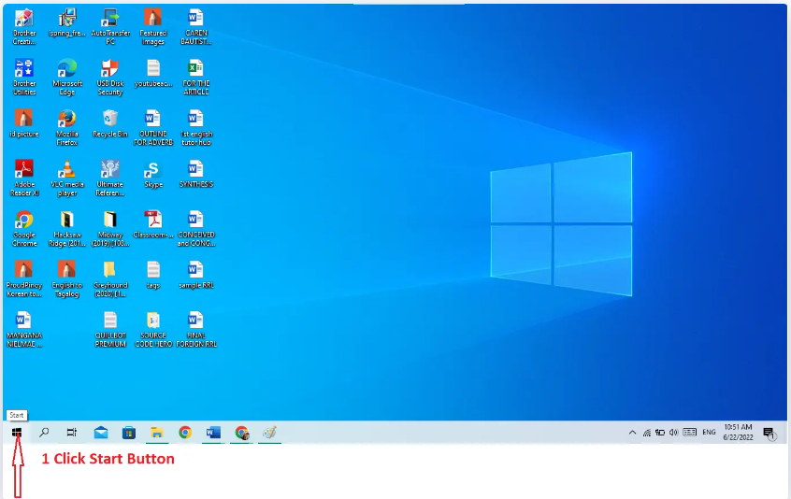
STEPS ON HOW TO START MS WORD
Step 1 − Click the Start button.

Slide 4
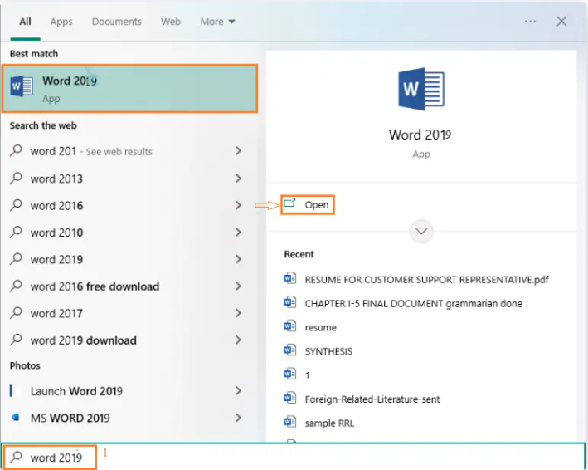
STEPS ON HOW TO START MS WORD
Step 2− Search for Microsoft Office Word.

Slide 5
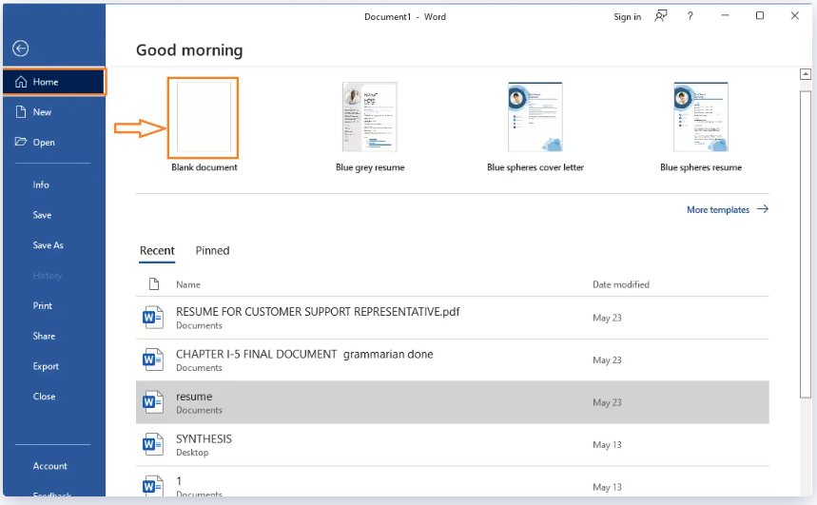
Step 3– After you see Microsoft Word from menu click it. This will launch the Microsoft Word application and you will see the following window.
STEPS ON HOW TO START MS WORD

Slide 6
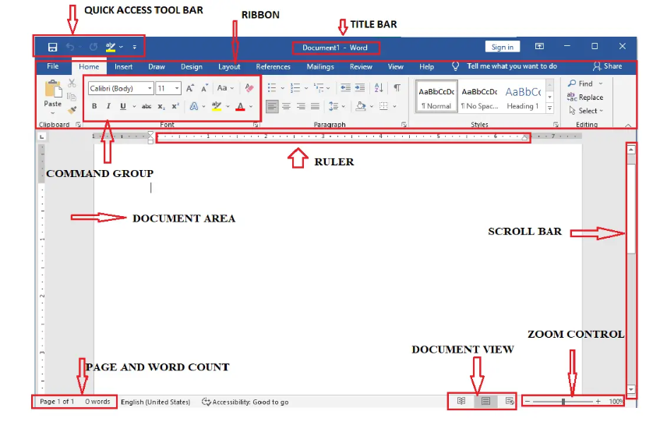
BASIC PARTS OF MS WORD WINDOW

Slide 7
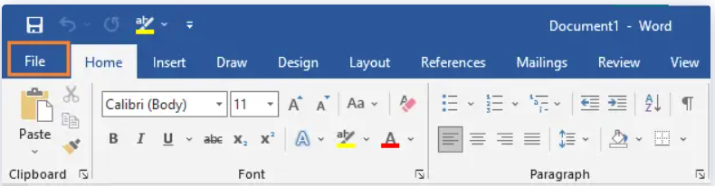
BASIC PARTS OF MS WORD WINDOW AND ITS FUNCTIONS
File tab is replaced in Office button. You can click it to see the back stage view. This is where you go to open or save a file, make a new document, print a document, or do anything else that has to do with files

Slide 8
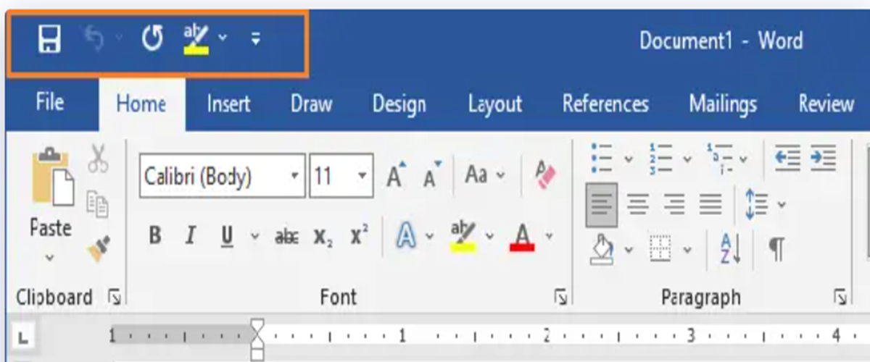
BASIC PARTS OF MS WORD WINDOW AND ITS FUNCTIONS
Quick Access Toolbar is one of Microsoft most important parts. It is also at the top left corner of the screen, right above the File Tab. It is where the commands you use most often are kept. By default, it includes the Save, Undo, and Redo commands You can change the way this toolbar looks to suit your needs

Slide 9
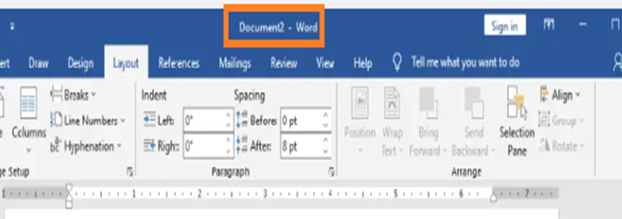
BASIC PARTS OF MS WORD WINDOW AND ITS FUNCTIONS
Title bar is a component of the Word window. It is situated at the top and middle of the document window and displays the program or document’s name. When we save our document, we have the option of giving it a new name that is more appropriately associated with our file.

Slide 10
BASIC PARTS OF MS WORD WINDOW AND ITS FUNCTIONS
Ribbon contains multiple tabs, which you can find near the top of the MS Word window. Word uses a tabbed Ribbon system instead of traditional menus. The Ribbon contains all of the commands you will need to perform common tasks in Word. It has multiple tabs, each with several groups of commands

Slide 11
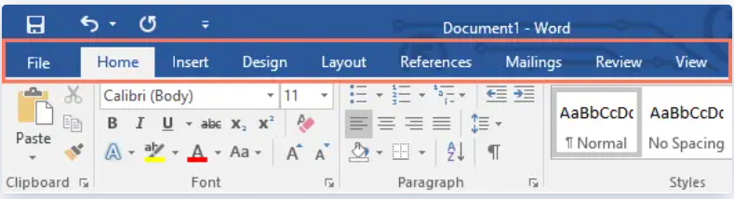
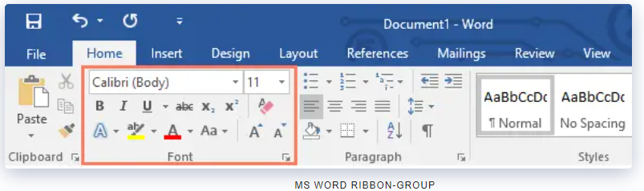
Tabs − These appear across the top of the Ribbon and contain groups of related commands. Home, Insert, Page Layout are examples of ribbon tabs.
Groups − They organize related commands; each group name appears below the group on the Ribbon. For example, group of commands related to fonts or group of commands related to alignment, etc

Slide 12
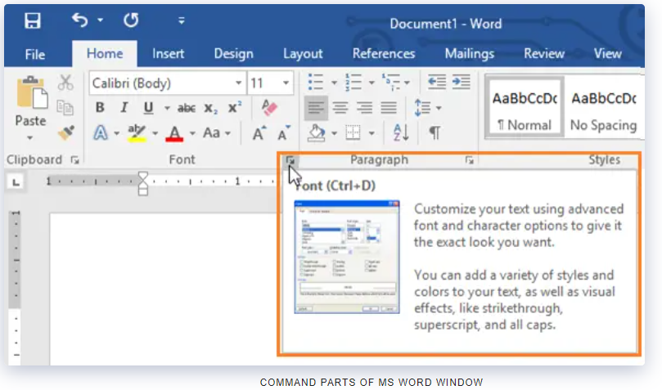
Commands − Commands appear within each group as mentioned above. Some groups also have a small arrow in the bottom-right corner that you can click for even more options

Slide 13
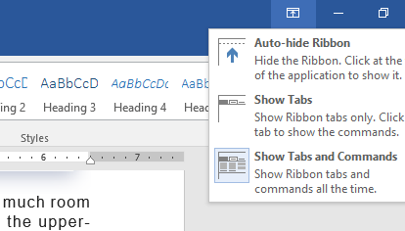
SHOWING AND HIDING RIBBON
Auto-hide Ribbon: Auto-hide makes your document fill the whole screen and hides the Ribbon completely.
Show Tabs: When this option is turned on, all command groups will be hidden when they are not being used. Tabs will still be shown.
Show Tabs and Commands: This option makes the Ribbon bigger. You will be able to see all of the tabs and commands.

Slide 14
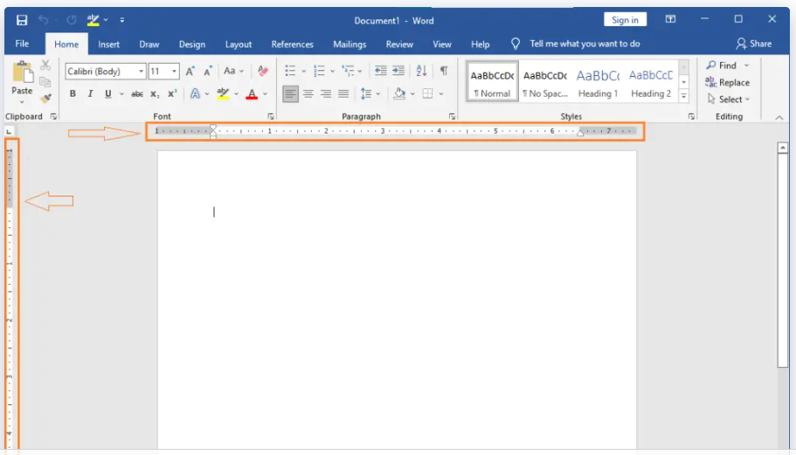
RULERS
Word has two rulers: one horizontal and one vertical.
Horizontal ruler, which appears just below the Ribbon, is used to set margins and tab stops.
Vertical ruler, which can be found on the left edge of the Word window, is used to determine the vertical position of elements on the page

Slide 15
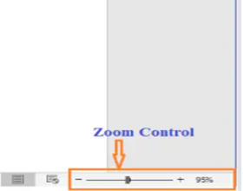
BASIC PARTS OF MS WORD WINDOW AND ITS FUNCTIONS
Zoom control consists of a slider that you can slide left or right to zoom in or out; you can increase or decrease the zoom factor by clicking the + buttons. Zooming in allows you to get a better look at your text. To zoom in or out, click and drag the zoom control slider in the bottom-right corner of the Word window. You can also select the + or – commands to zoom in or out by smaller increments. The number next to the slider displays the current zoom percentage, also called the zoom level

Slide 16
BASIC PARTS OF MS WORD WINDOW AND ITS FUNCTIONS
View Buttons. Word View Buttons gives you a number of ways to change how your document is shown. Further, this part of the window allows you to choose and view your document in Read Mode, Print Layout, or Web Layout. You can use these views for different tasks, especially if you want to print the document.

Slide 17
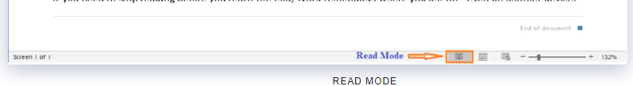
VARIOUS WAYS TO VIEW DOCUMENT
Read Mode. This view opens the document to a full screen. This view is great for reading large amounts of text or simply reviewing your work.

Slide 18
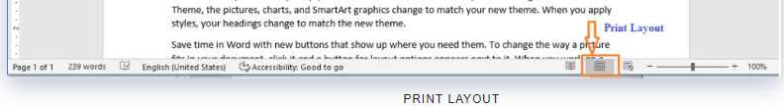
VARIOUS WAYS TO VIEW DOCUMENT
Print Layout view displays pages exactly as they will appear when printed. This is the default document view in Word. It shows what the document will look like on the printed page.

Slide 19
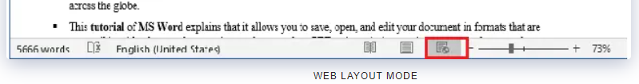
VARIOUS WAYS TO VIEW DOCUMENT
Web Layout view shows how a document appears when viewed by a Web browser. This view displays the document as a webpage, which can be helpful if you’re using Word to publish content online.

Slide 20
REFERENCES
Website:
Fungsi Motherboard Processor Memori Dan Harddisk | Computer hardware, Computer hardware store, Computer Pinterest. https://www.pinterest.ph/pin/88594317657692933/?mt=login
Unit 4 - Hardware & Ergo - Davids BTA30 Portfolio 2016 Sites.google.com. https://sites.google.com/site/davidsbtaportfolio/unit-4---hardware-ergo.
Computer Software Icon #229946 - Free Icons Library. Icon-library.com. https://icon-library.com/icon/computer-software-icon-14.html
https://edu.gcfglobal.org/en/word2016/understanding-onedrive/1/
https://www.rapidtables.com/code/text/ascii-table.html
https://www.vskills.in/certification/tutorial/ms-word-interface-and-editing-document/
https://itsourcecode.com/ms-word/ms-word-window-explore-its-features/

Slide 21
--- END ---

